Slide 1
Happy crayons

Slide 2
About our project
Our project started on the end of May. On the plan was making happy crayons. We drilled holes into the branches. We gave the color graphites into the holes. And we decorated it. The project made three girls- Karolína Halířová, Anna Pavelková and Jolien Dewulf. We used ekology materials- wood, paper and color. We made six pencils. I three pencils and Kája three pencils. Jolien will make three pencils. Our project will be end in June.

Slide 3
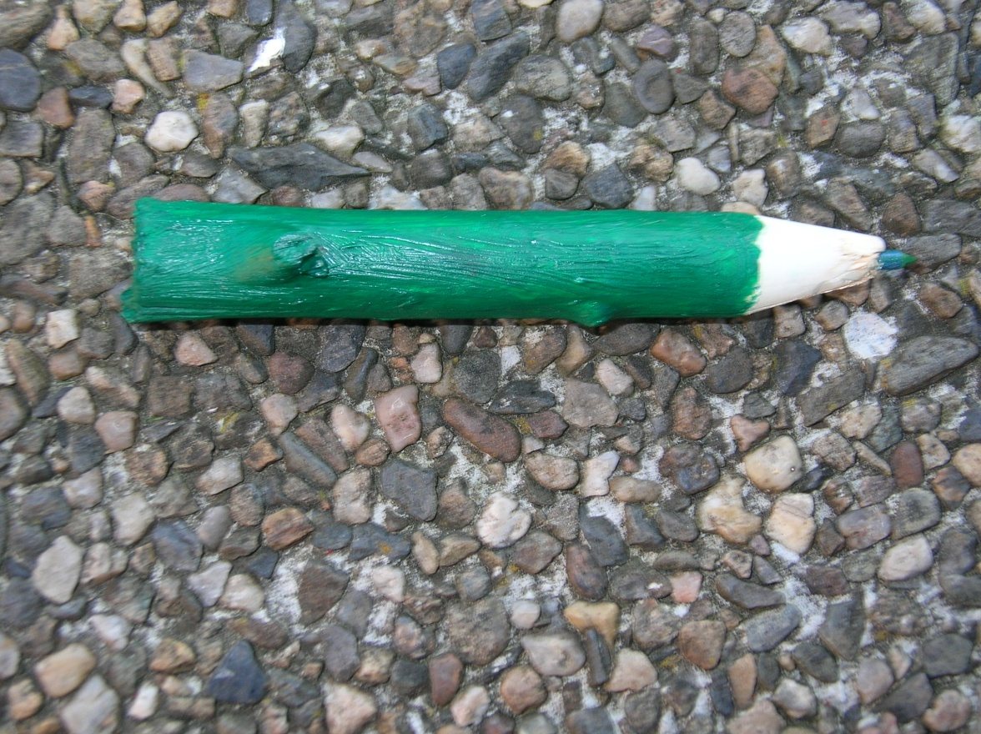
My 1. crayon

Slide 4
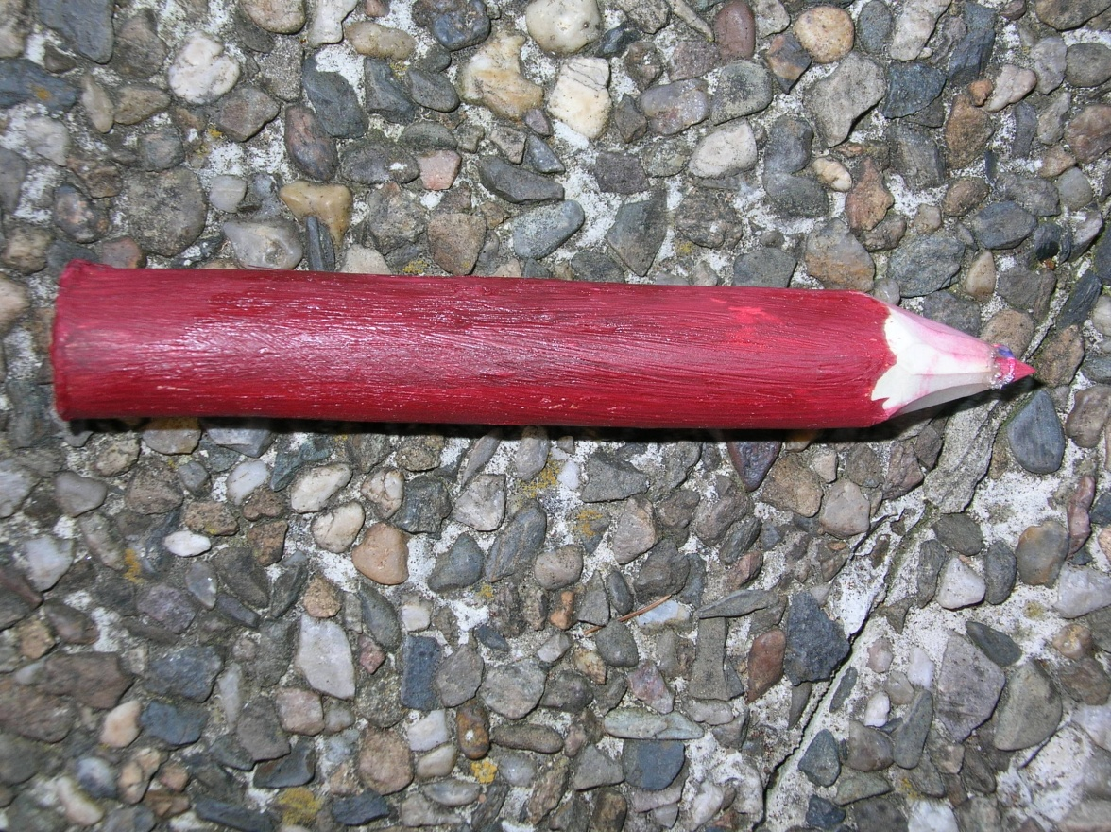
My 2. crayon

Slide 5
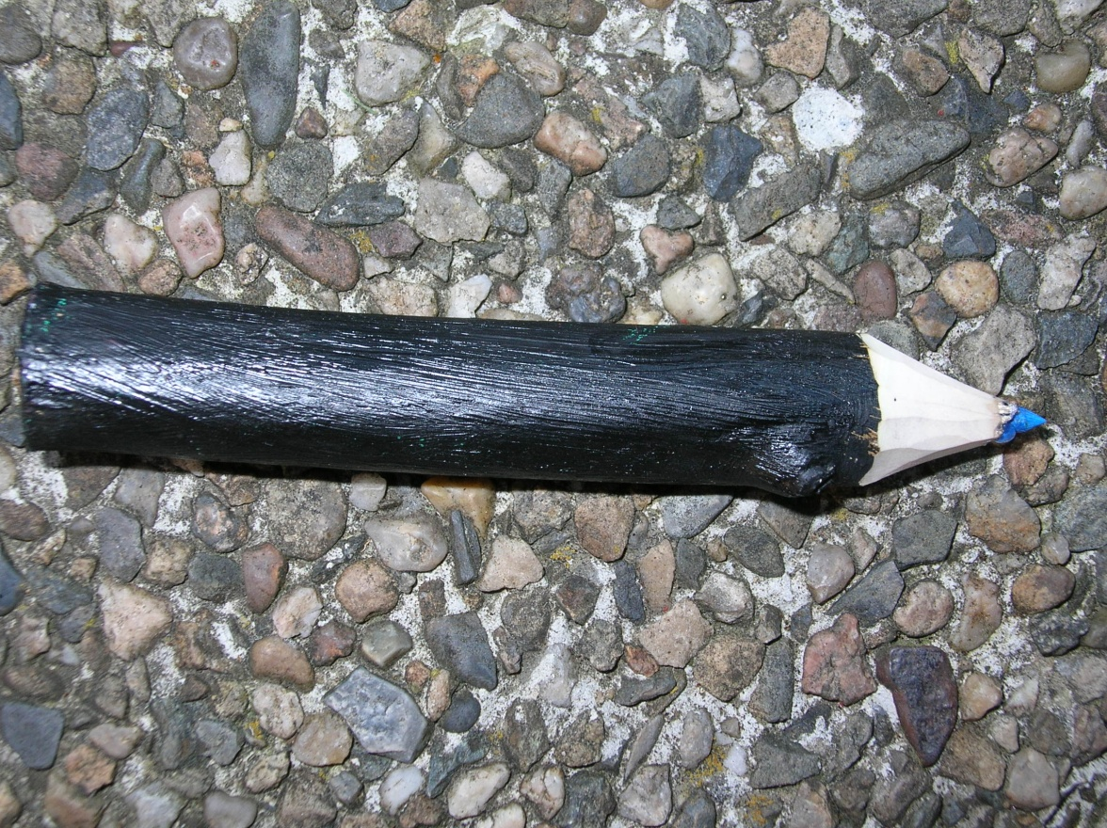
My 3. crayon

Slide 6
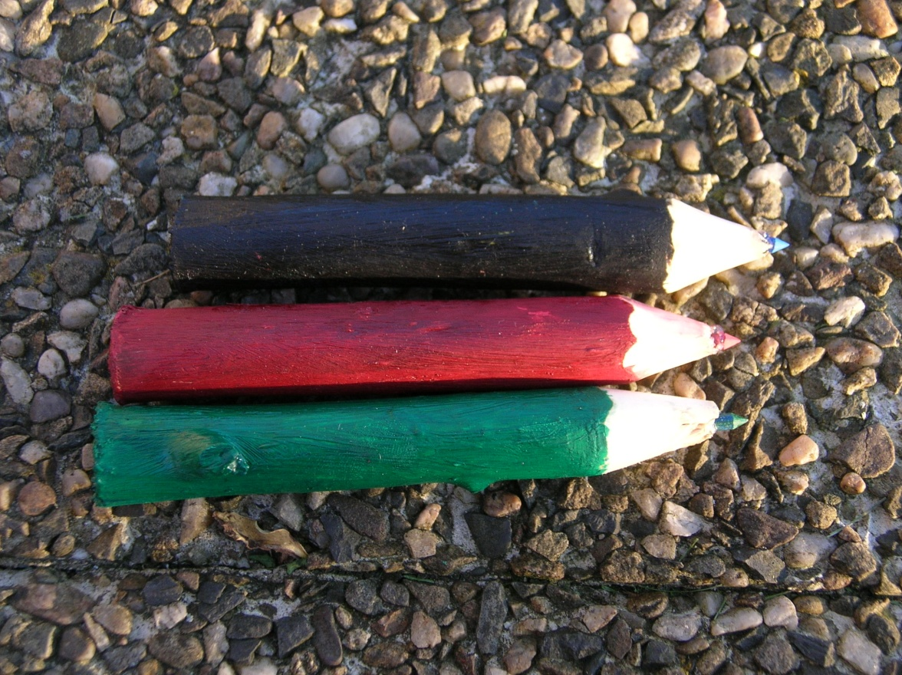
All crayons

Slide 7




